Slide 1
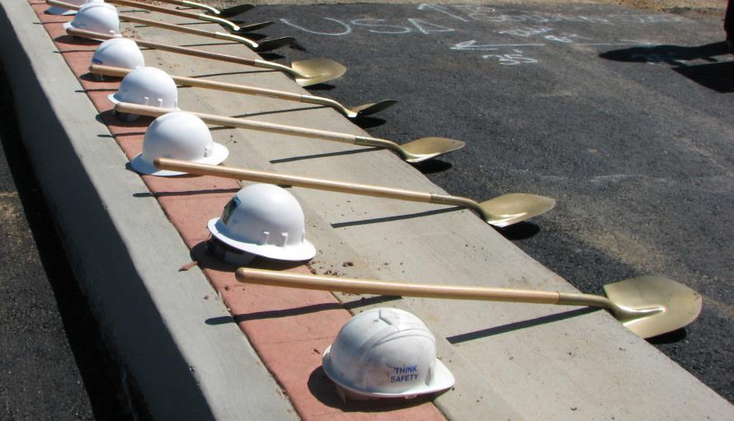
Using social media and tools for Economic Development
Julie Herd
Business Development & Marketing Manager
Madera County Economic Development Commission

Slide 2
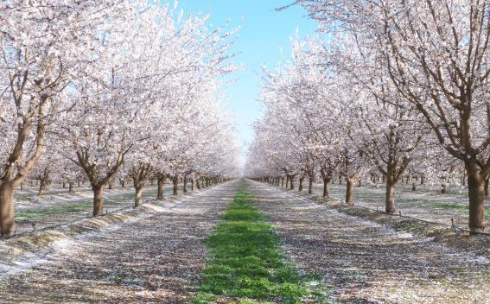
This is Home
Population: 150,000 est.
Median Household Income: $45,625
Primary Industries:
Agriculture, Government & Health Services
7 Million Square Feet of Industrial Space
2 Distinct Economies

Slide 3
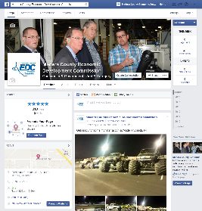
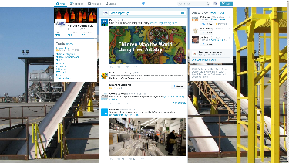
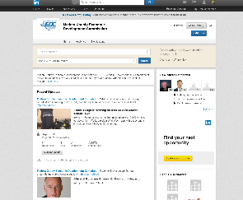
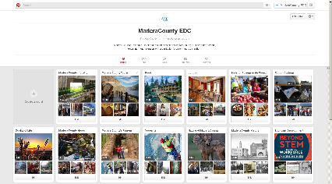
Social Media Accounts

Slide 4
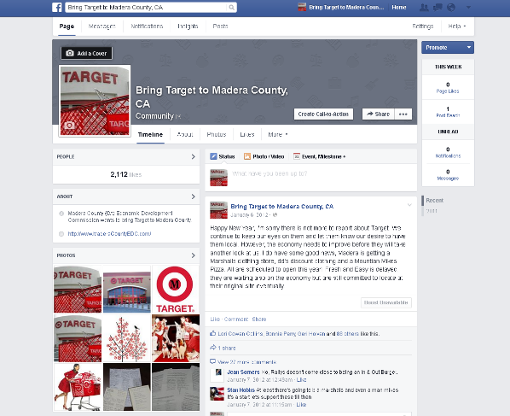
Facebook
Campaign

Slide 5
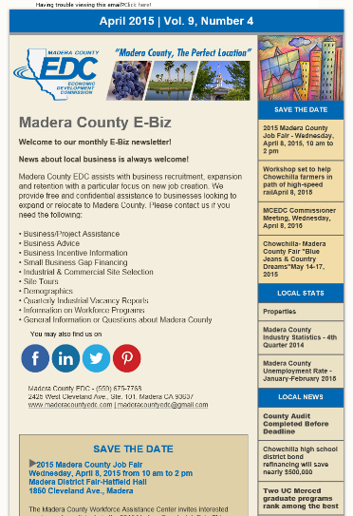
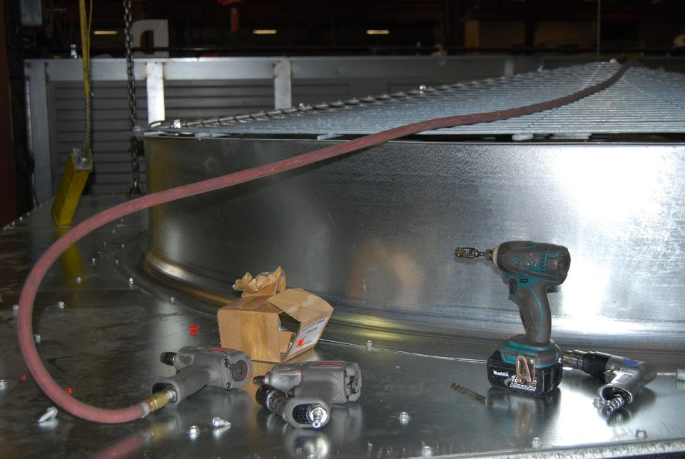
Other Tools

Slide 6
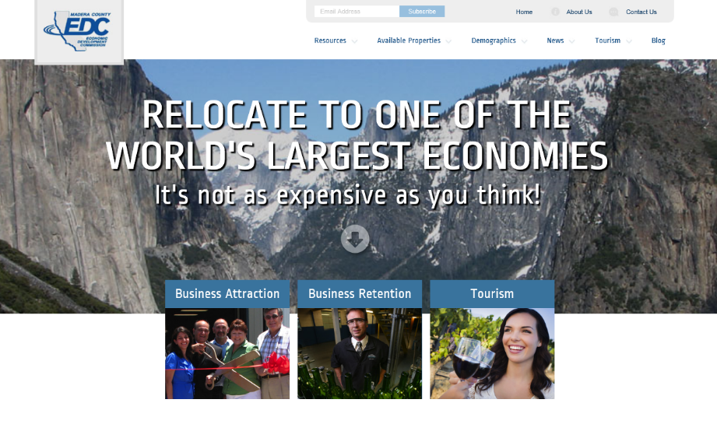
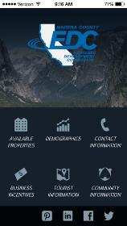
Sister App

Slide 7
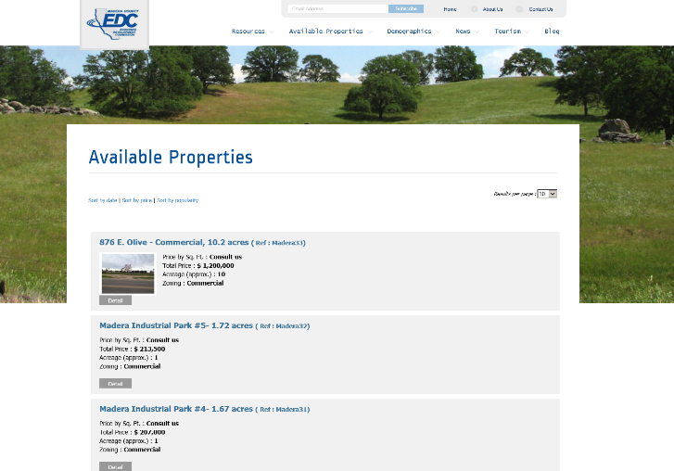
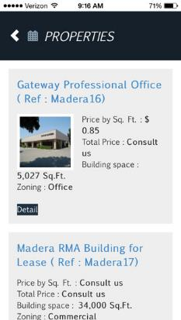

Slide 8
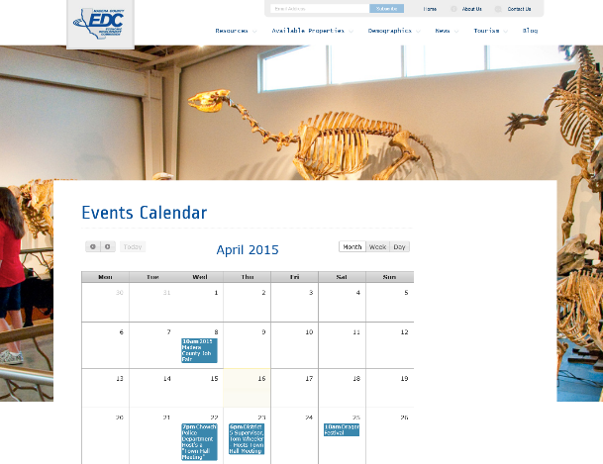
Blend your website
into Social media

Slide 9
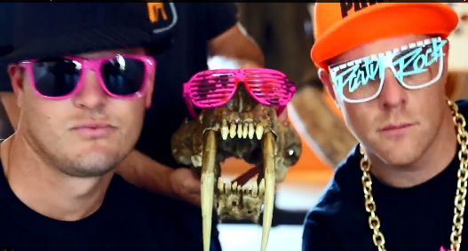
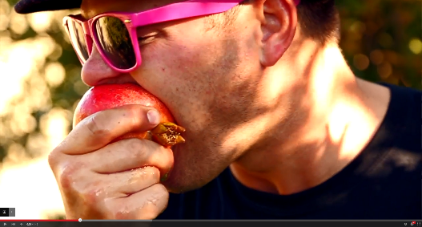
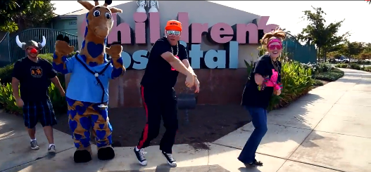
Video
Promoting
the
Pomegranate Festival
18,700 views

Slide 10
THANK YOU

